Slide 1

STA 610: Case Study
Presenter: Zixiao Tan

Slide 2
Overview
Introduction
Modeling: Random Effect w/ Fixed Effect
Estimation: Frequentist vs Bayesian
Inference: Frequentist Perspective

Slide 3
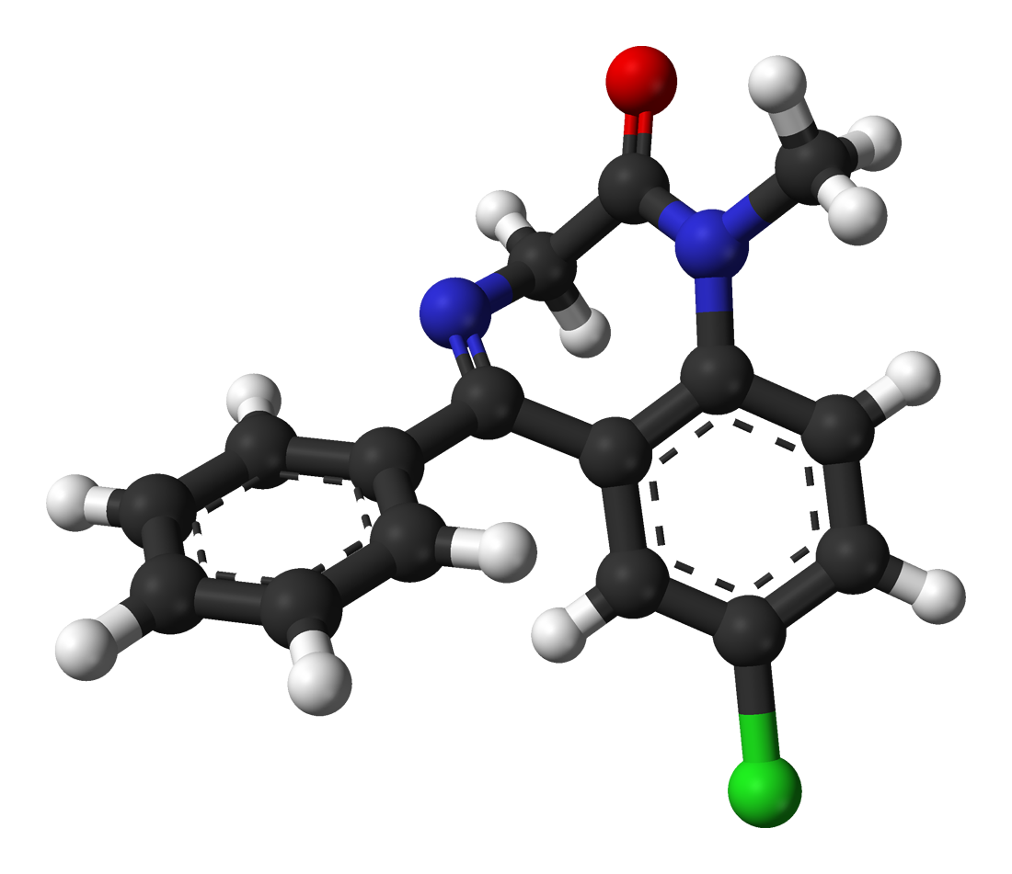
Introduction
Background: Using StreetRx data to investigate factors related to price per mg of Diazepam
Goal:
Which factors associated with ppm of diazepam?
Is there heterogeneity in pricing of diazepam by location?

Slide 4
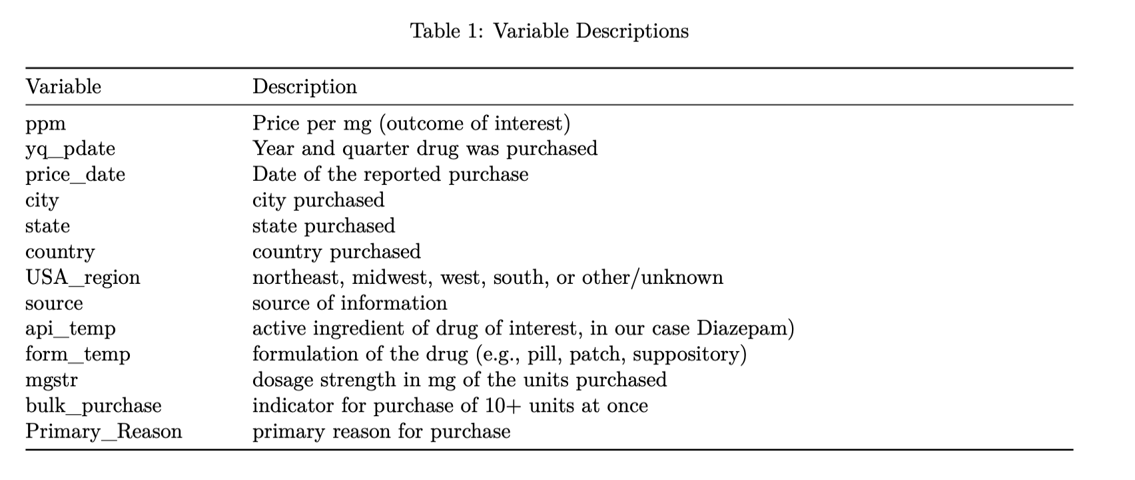
EDA-Variable
Data En: Using StreetRx data to investigate factors related to price per mg of Diazepam
Goal:
Which factors associated with ppm of diazepam?
Is there heterogeneity in pricing of diazepam by location?

Slide 5


Data Cleaning
Data Entry Error:
Source: 2 obs w/ “fuck u” and “Eronhkkjhhhhjj”.
Missing data:
Remove obs without ppm
Remove primary_reason (over 50% missing)
Uninformative data:
country (always USA), form_temp(always pills)

Slide 6
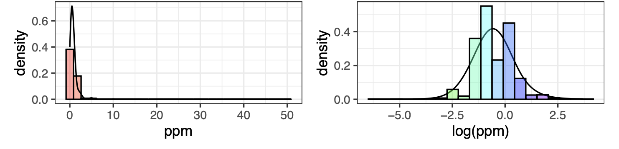
Outcome variable:ppm
Log transformation of ppm
Left: highly right-skewed ➡️ right: relatively normal and symmetric

Slide 7
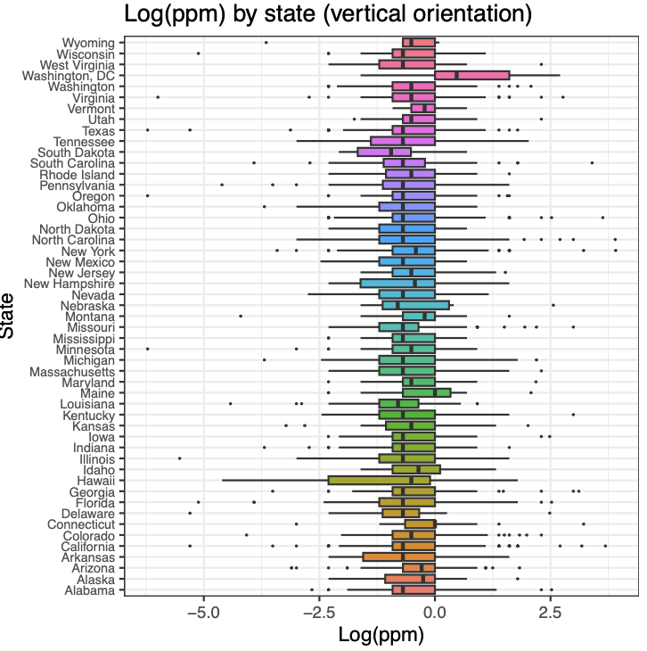
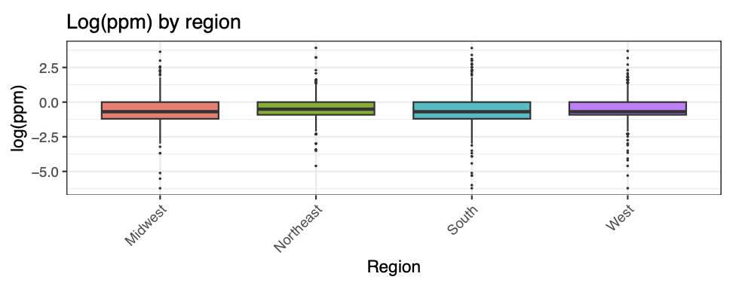
Random Effect
State: some variation by state ✅
Region: not much variation by region ❌
city: many data entry error ❌

Slide 8
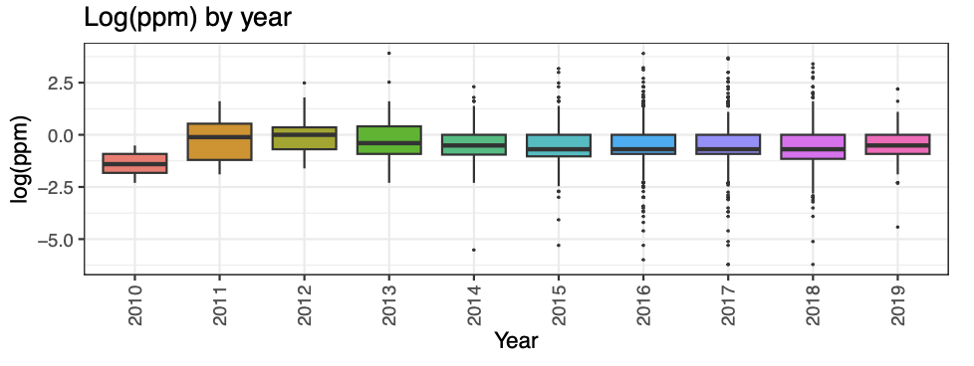
Fixed Effect-continuous
year: box plot show variations across year ➡️ include year as Fixed Effect

Slide 9
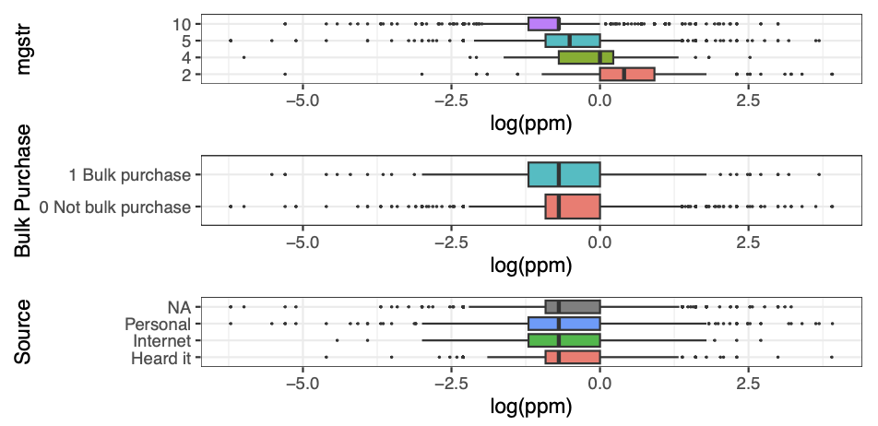
Fixed Effect-factor
mgstr (dosage strength): factor variable
2, 4, 5, 10 mg
Bulk Purchase:
Binary (0/1)
Source:
3 level

Slide 10
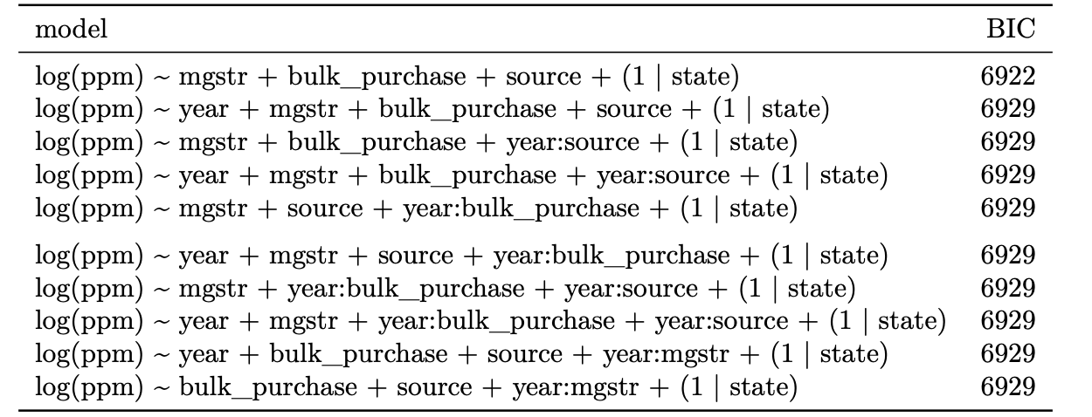
Model Selection
Fixed Effect (4): mgstr, bulk_purchase, source, year. Random Effect: state
Two-way Interaction(6): ➡️ 2^10 = 1024 possible models
Select model with smallest BIC: no two-way interaction
✅

Slide 11
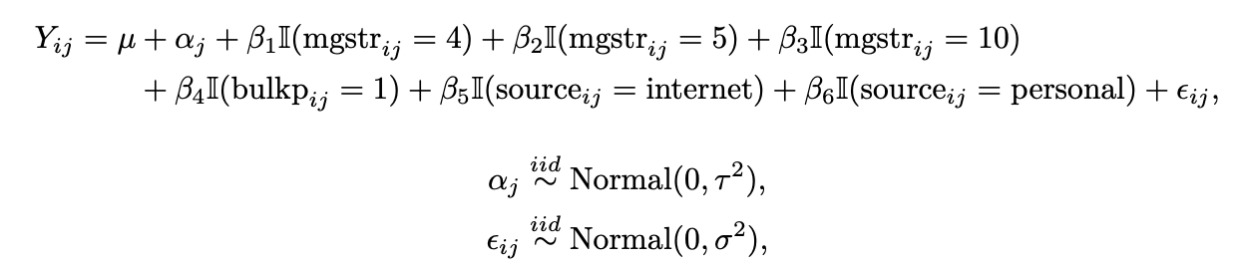
Final Model
Fixed Effect (3): mgstr, bulk_purchase, source
Random Effect: state
No Two-way Interaction based on BIC criteria

Slide 12
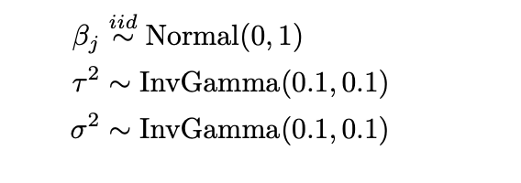
Estimation
Frequentist: MLE
Estimate via lme4 package in R
Bayesian:
Do not have much information about the model ➡️ uninformative prior

Slide 13
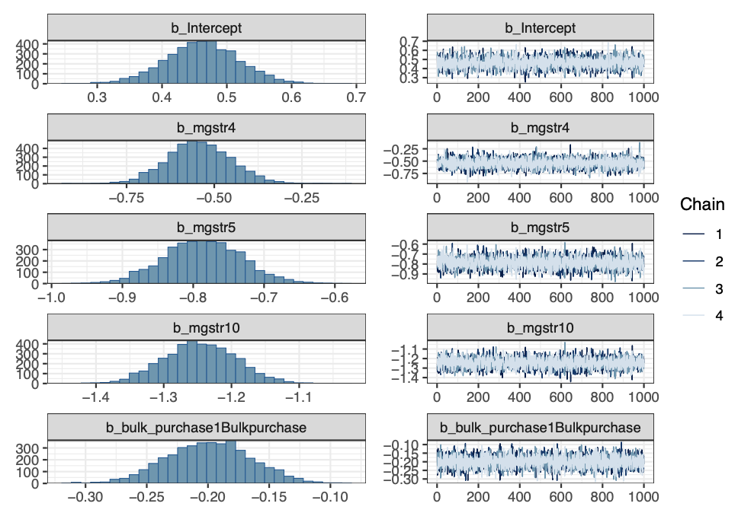
Bayesian Estimation
Posterior Check
The plot shows posterior
distributions for all parameter
Traceplot
sampling chains converge

Slide 14
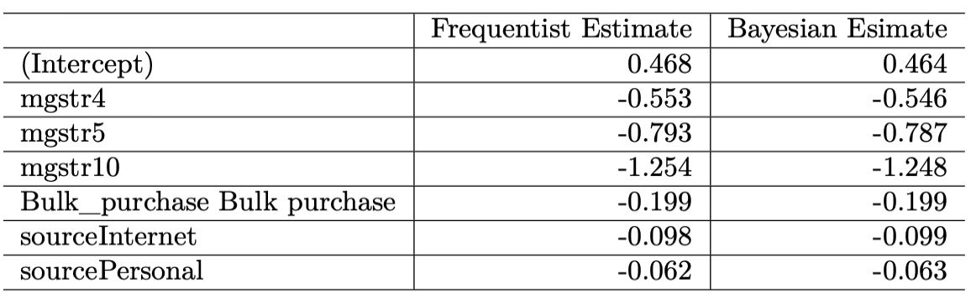
Model Comparison
Frequentist vs Bayesian
Compare the point estimates of the parameter, almost the same
Interpretation: choose frequentist model

Slide 15
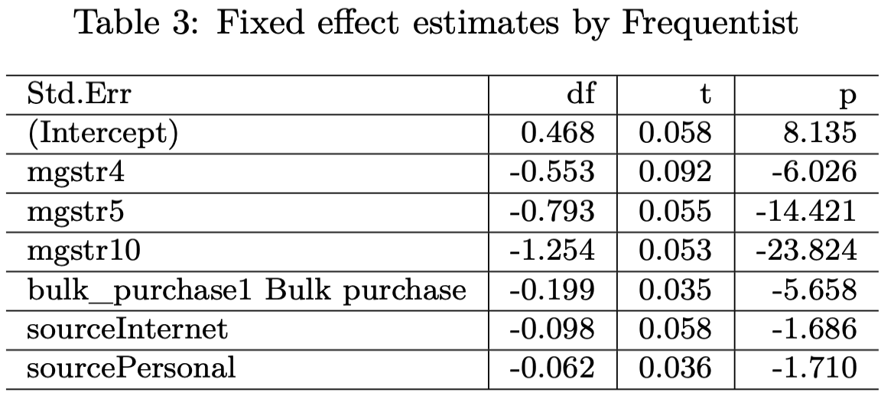
Fixed Effect
Dosage( Reference level 2mg)
Price per mg decreases as dosage increases. Relative to 2mg pills, 10mg pills are 71.5% cheaper (e^{-1.254} = 0.285).

Slide 16
Fixed Effect
Bulk ( Reference level “ no bulk purchase”)
Purchasing in bulk offers an 18% discount compared to single purchases (e^{-0.199} = 0.820).

Slide 17
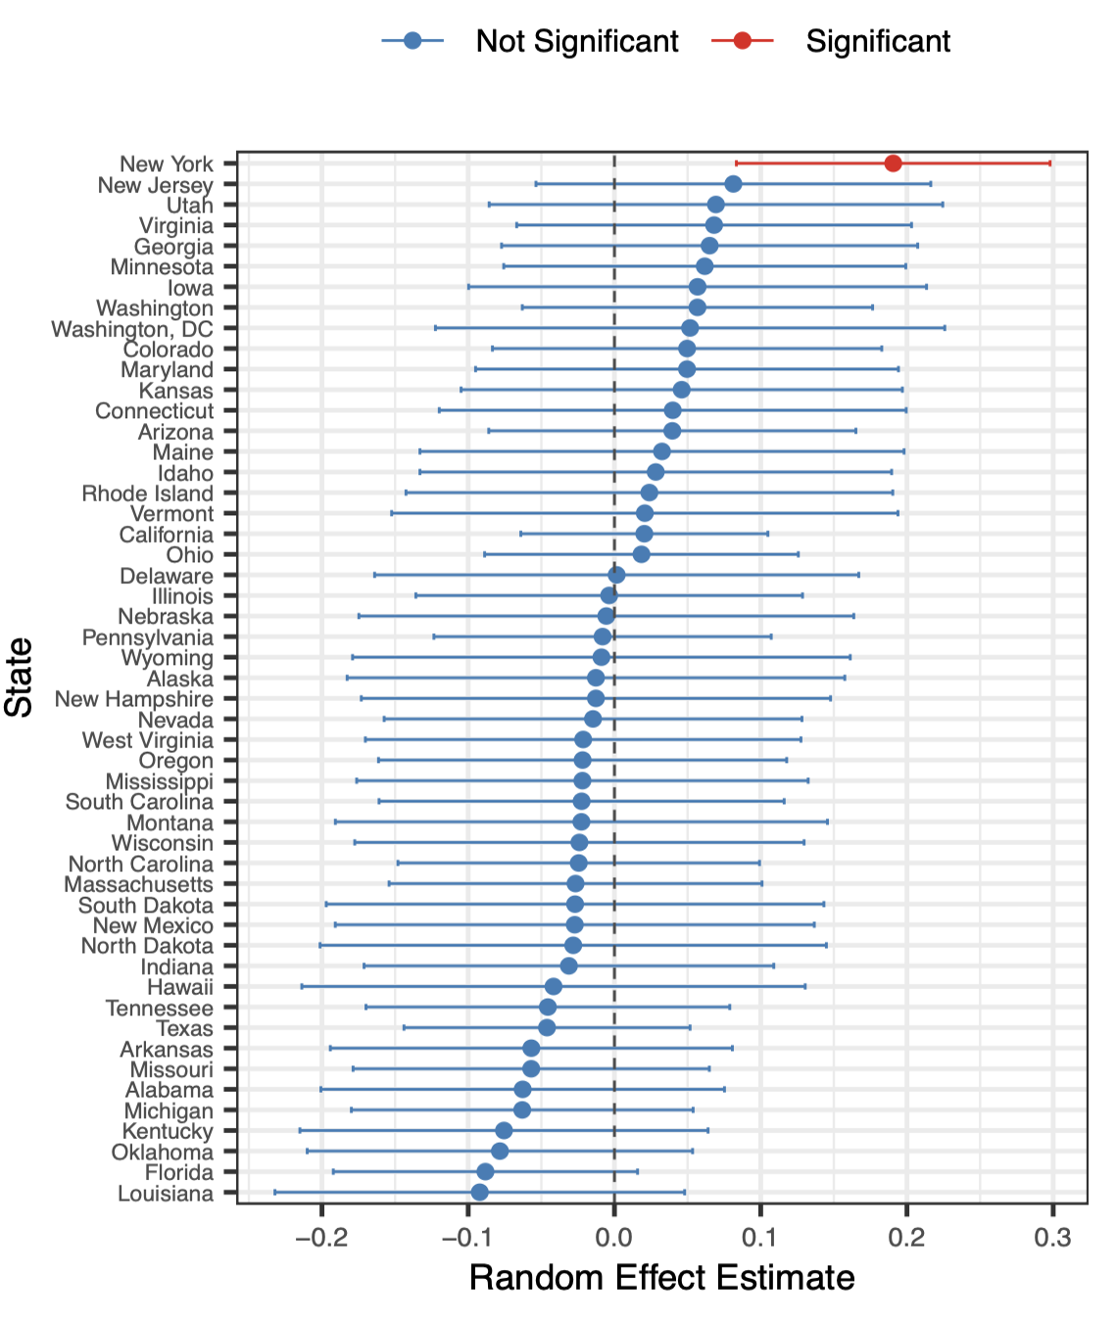
Random Effect
General pattern
Most states’ confidence intervals cross zero,
baseline prices do not differ significantly
from the national average.
Exception:
New York state CI does not contain 0

Slide 18
Random Effect
General pattern
Most states’ confidence intervals cross zero,
Exception: New York State
a significantly higher baseline price in
New York compared to other states.

Slide 19
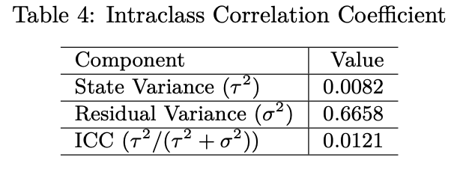
Inference
Intraclass Correlation (ICC)
only 1.2% of price variability is explained by between-state differences.
vast majority (98.8%) is attributable to within-state variance

Slide 20
Thank you!

